Slide 1
First week of my internship
Shin YASUDA

Slide 2
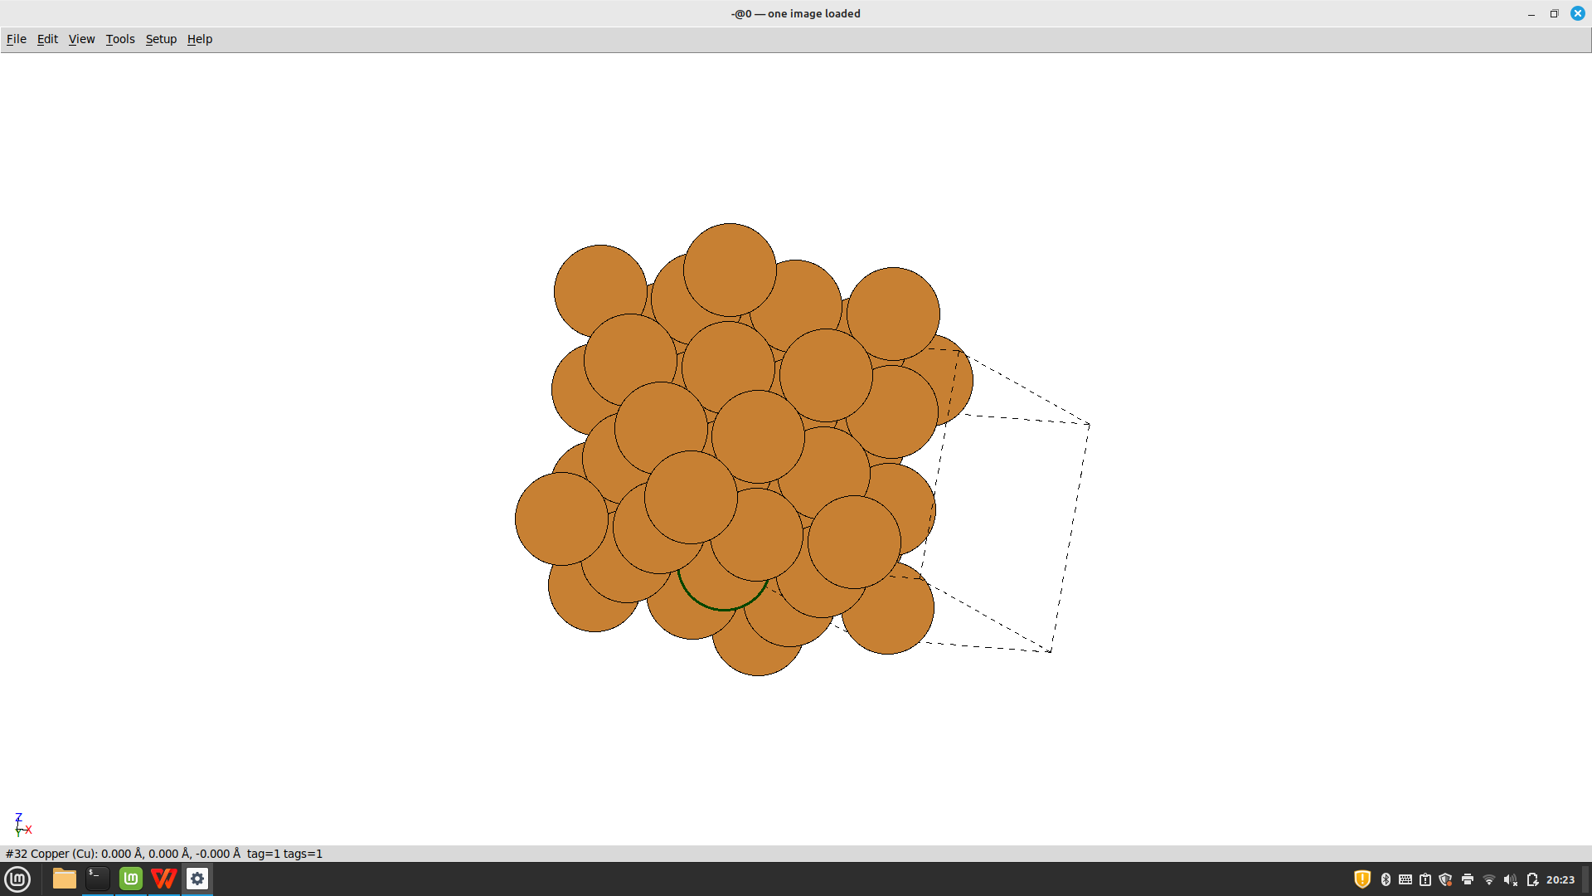
Test cluster
50 Cu(001)
2p3/2
95.0 eV
emitter Cu

Slide 3
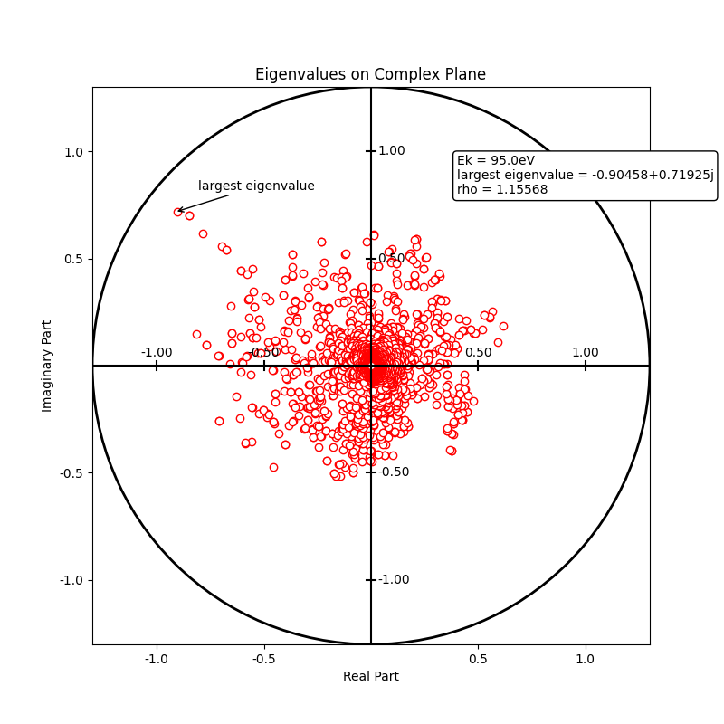
Eigenvalues spectrum
Many eigenvalues in the vicinity of the origin
--> might be removed to get a fake cluster ?

Slide 4
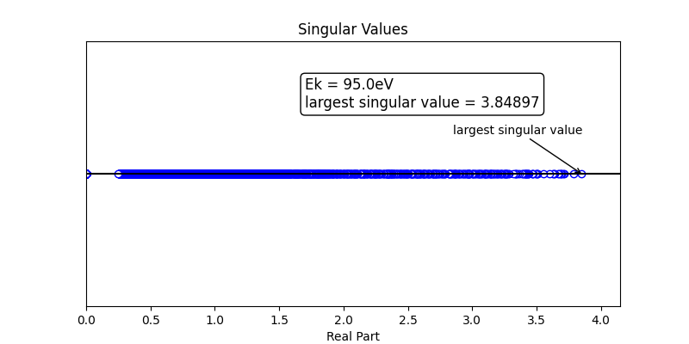
Singular values spectrum
All points on the real line and positive

Slide 5
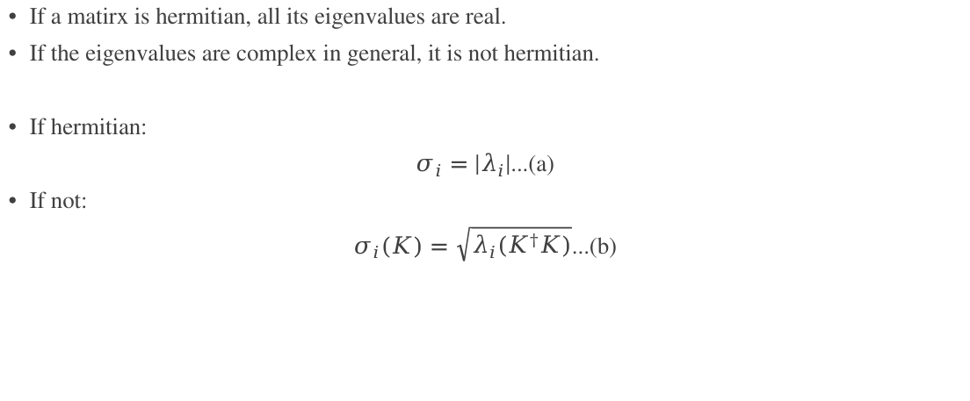
Is the kernel matrix hermitian ?
If a matirx is hermitian, all its eigenvalues are real.
If the eigenvalues are complex in general, it is not hermitian.
If hermitian:
$σ_{i}=|λ_{i}|$...(a)
If not:
$σ_{i}(K)=\sqrt{λ_{i}(K^{†}K)}$...(b)

Slide 6
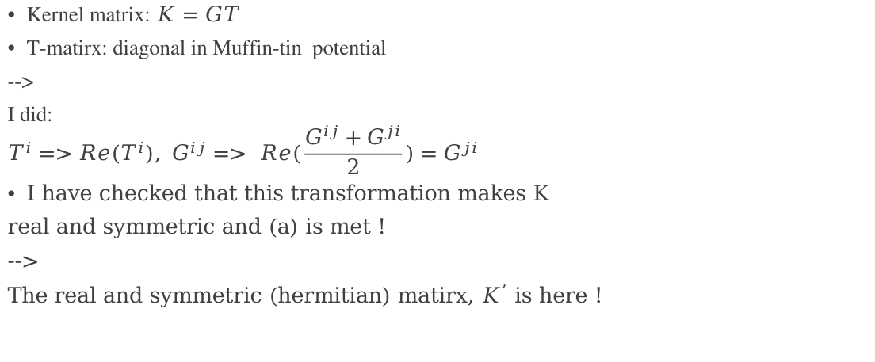
Hermitianization ~ method ~
(lmax+1)²*Nat
(lmax+1)²
T¹
T¹
G¹²
G¹³
G¹⁴
Kernel matrix: $K=GT$
T-matirx: diagonal in Muffin-tin potential
-->
I did:
$$T^{i}=>Re(T^{i}), G^{ij}=> Re(\frac{{G^{ij}+G}^{ji}}{2})=G^{ji}$$
I have checked that this transformation makes K
real and symmetric and (a) is met !
-->
The real and symmetric (hermitian) matirx, $K^{’}$ is here !
G²¹
T²
G²³
G²⁴
G³¹
G³²
G³⁴
T³
G⁴¹
G⁴²
G⁴³
T⁴

Slide 7
Hermitianization ~ eigenvalues ~
abs(Eigenvalues):
1.85034 >1
1.76525
1.72166
1.56358
1.53792 1.5283
1.49116
1.48269
1.47524
1.46331
1.46198
1.44232
1.43223
.
.
.
What does this mean ?
Could we renormalize those values > 1 ?
If yes, what is the optimized omega parameter ?

Slide 8
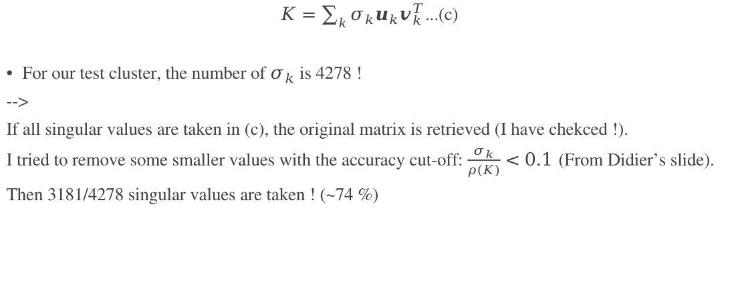
SVD ~ Matrix Reconstruction ~
$K=\sum_{k}{σ_{k}u_{k}v_{k}^{T}}$...(c)
For our test cluster, the number of $σ_{k}$ is 4278 !
-->
If all singular values are taken in (c), the original matrix is retrieved (I have chekced !).
I tried to remove some smaller values with the accuracy cut-off: $\frac{σ_{k}}{ρ(K)}<0.1$ (From Didier’s slide).
Then 3181/4278 singular values are taken ! (~74 %)

Slide 9
SVD ~ Matrix Reconstruction ~
3181 singular values:
-0.84770327E+00
0.22862266E-03
-0.25329207E-03
0.33974232E-03
-0.17353776E-03
0.27376837E-03
-0.95154552E-06
-0.12666474E-03
0.10146049E-02
0.69165435E-02
.
.
.
-0.26448384E+00
0.29417407E+00
-0.24325669E+00
.
.
.
fully 4278 singular values:
-0.84733389E+00
-0.16300210E-04
-0.62698443E-07
-0.75805597E-04
0.39906384E-04
0.56833776E-03
-0.72665262E-04
-0.74189423E-04
0.81704666E-03
0.69554235E-02
.
.
.
-0.26551392E+00
0.29476488E+00
-0.24317048E+00
.
.
.
?
If the black values that are not important go to 0, canwe make a good fake ?

Slide 10
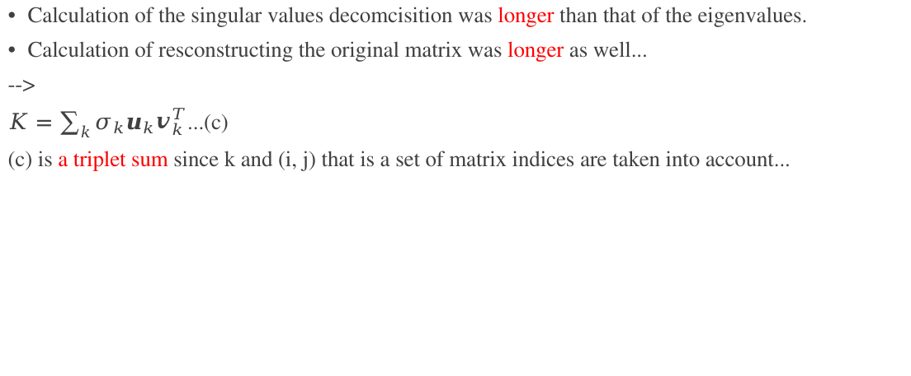
Concerns
Calculation of the singular values decomcisition was longer than that of the eigenvalues.
Calculation of resconstructing the original matrix was longer as well...
-->
$K=\sum_{k}{σ_{k}u_{k}v_{k}^{T}}$...(c)
(c) is a triplet sum since k and (i, j) that is a set of matrix indices are taken into account...

Slide 11
Atomic chain ~ 8 Cu ~
8 Cu atoms along z
95.0 eV
lmax = 8 or 9
2p3/2
z=0 (emitter)

Slide 12
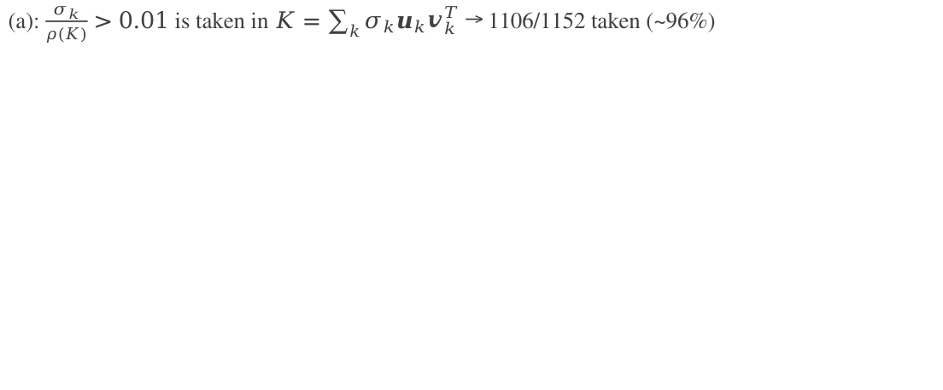
Comparison of the hermitianized matrix and reconstructued one
(a): $\frac{σ_{k}}{ρ(K)}>0.01$ is taken in $K=\sum_{k}{σ_{k}u_{k}v_{k}^{T}}$ → 1106/1152 taken (~96%)
Arroximated:
-0.40890374E+00
0.66603615E-03
-0.72974194E-03
-0.26571117E+00
0.30417314E+00
0.21518661E-03
-0.12694213E-02
0.82402784E-01
-0.88314554E-03
-0.17070305E-01
-0.78648503E-01
Original:
-0.40890264E+00
0.65037304E-03
-0.73675215E-03
-0.26572134E+00
0.30417659E+00
0.20315863E-03
-0.12720928E-02
0.82400175E-01
-0.88616546E-03
-0.17066624E-01
-0.78638839E-01
Red: mathcing up to the 1st demical.

Slide 13
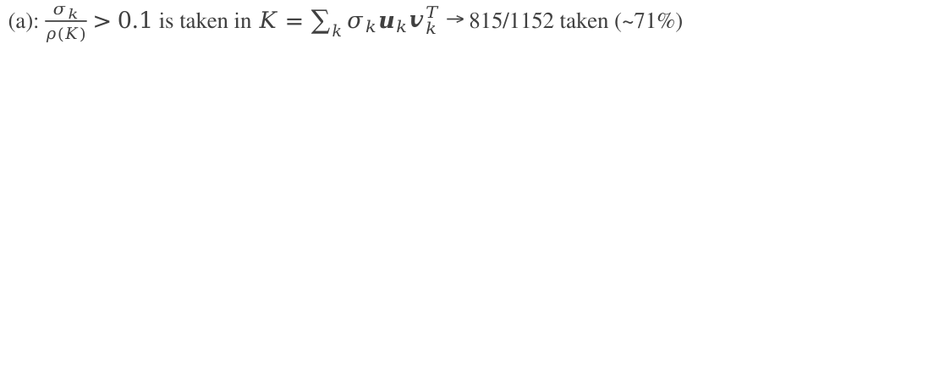
Comparison of the hermitianized matrix and reconstructued one
(a): $\frac{σ_{k}}{ρ(K)}>0.1$ is taken in $K=\sum_{k}{σ_{k}u_{k}v_{k}^{T}}$ → 815/1152 taken (~71%)
Appriximated:
-0.40947550E+00
0.89355787E-03
-0.12985172E-02
-0.26639887E+00
0.30429316E+00
-0.27050041E-03
-0.11868897E-02
0.82587690E-01
-0.91638503E-03
-0.16553691E-01
-0.78374872E-01
Original:
-0.40890264E+00
0.65037304E-03
-0.73675215E-03
-0.26572134E+00
0.30417659E+00
0.20315863E-03
-0.12720928E-02
0.82400175E-01
-0.88616546E-03
-0.17066624E-01
-0.78638839E-01

Slide 14
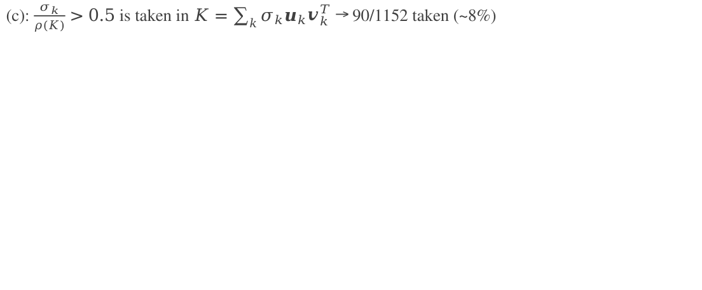
Comparison of the hermitianized matrix and reconstructued one
(c): $\frac{σ_{k}}{ρ(K)}>0.5$ is taken in $K=\sum_{k}{σ_{k}u_{k}v_{k}^{T}}$ → 90/1152 taken (~8%)
Approximated:
-0.44464337E+00
0.26170324E-02
-0.72040590E-02
-0.26355794E+00
0.31881530E+00
0.24985082E-01
-0.23684901E-02
0.12276639E+00
-0.10554706E-01
-0.20612284E-01
-0.70923329E-01
Original:
-0.40890264E+00
0.65037304E-03
-0.73675215E-03
-0.26572134E+00
0.30417659E+00
0.20315863E-03
-0.12720928E-02
0.82400175E-01
-0.88616546E-03
-0.17066624E-01
-0.78638839E-01

Slide 15
report
Test chains:
(a) 7-Ni chain
2p3/2, 379.1 eV
(b) 12-TiO chain
2p3/2, 1019 eV
(c) 8-SrSr chain
3d, 1134 eV
(a)
(b)
(c)
z
O
Ni
Ti
Sr
0

Slide 16
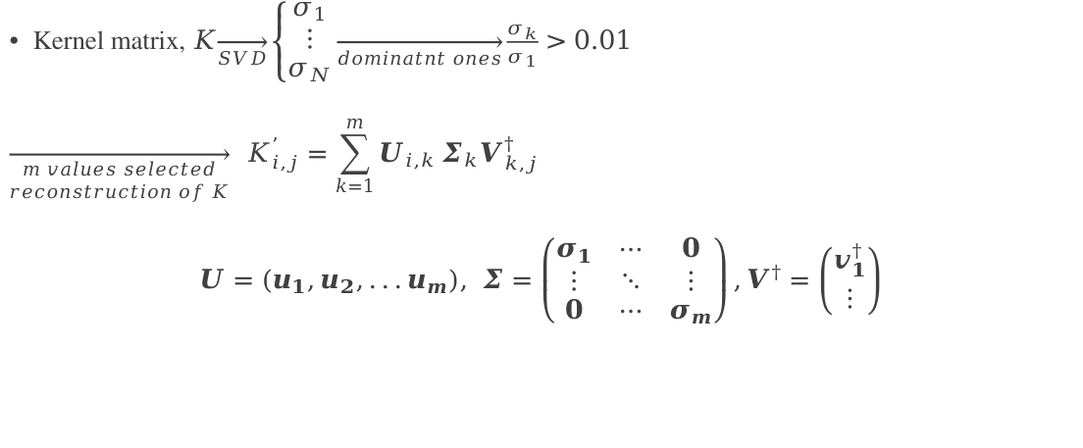
SVD of the atomic chains ~ method (2) ~
Kernel matrix, $K\overset{→}{SVD}\left\{\begin{aligned}σ_{1} \\ ⋮ \\ σ_{N}\end{aligned}\right.\overset{→}{dominatnt ones}\frac{σ_{k}}{σ_{1}}>0.01$
$$\overset{→}{\begin{aligned}m values selected \\ reconstruction of K\end{aligned}}{ K}_{i,j}^{’}=\sum_{k=1}^{m}{U_{i,k}}Σ_{k}V_{k,j}^{†}$$
$$U=\left(u_{1},u_{2},...u_{m}\right), Σ=\left(\begin{matrix}σ_{1} & ⋯ & 0 \\ ⋮ & ⋱ & ⋮ \\ 0 & ⋯ & σ_{m}\end{matrix}\right),V^{†}=\left({v_{1}^{†} \atop ⋮}\right)$$
If we count i and j from 0 to N, the dimension of K’ is the same as K, but considering only up to p (< N), it may be a fake cluster...

Slide 17
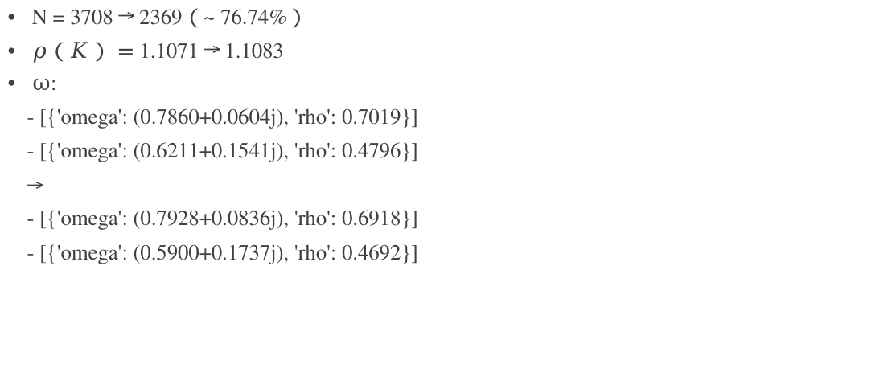
SVD of the atomic chains ~ (a) ~
(a)
N = 3708 → 2369（~ 76.74%）
$ρ（K）=$ 1.1071 → 1.1083
$ω$:
- [{'omega': (0.7860+0.0604j), 'rho': 0.7019}]
- [{'omega': (0.6211+0.1541j), 'rho': 0.4796}]
→
- [{'omega': (0.7928+0.0836j), 'rho': 0.6918}]
- [{'omega': (0.5900+0.1737j), 'rho': 0.4692}]
Ni

Slide 18
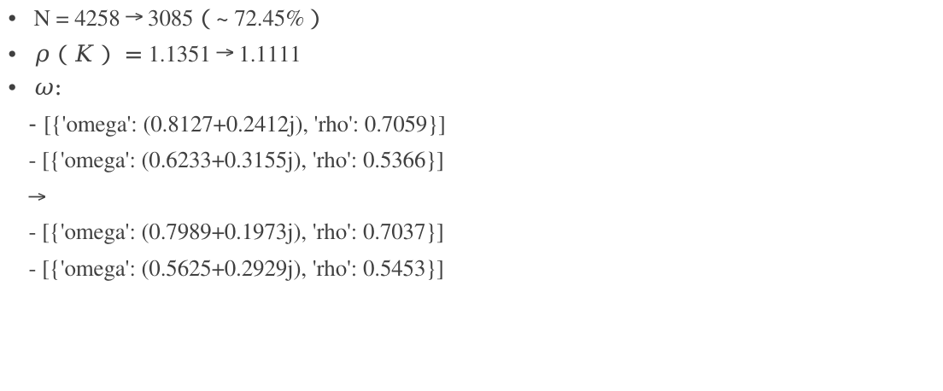
SVD of the atomic chains ~ (b) ~
(b)
N = 4258 → 3085（~ 72.45%）
$ρ（K）=$ 1.1351 → 1.1111
$ω$:
- [{'omega': (0.8127+0.2412j), 'rho': 0.7059}]
- [{'omega': (0.6233+0.3155j), 'rho': 0.5366}]
→
- [{'omega': (0.7989+0.1973j), 'rho': 0.7037}]
- [{'omega': (0.5625+0.2929j), 'rho': 0.5453}]
O
Ti

Slide 19
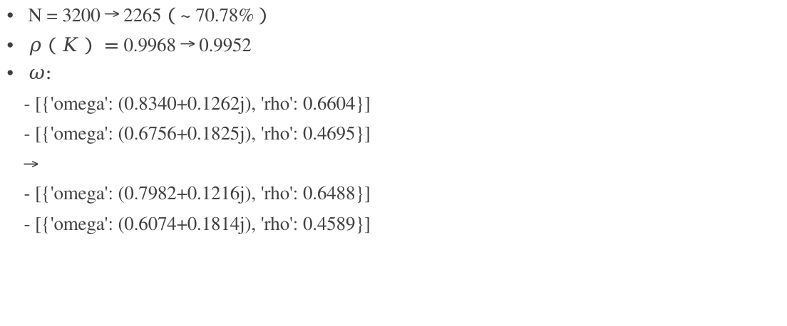
SVD of the atomic chains ~ (c) ~
(c)
z
N = 3200 → 2265（~ 70.78%）
$ρ（K）=$ 0.9968 → 0.9952
$ω$:
- [{'omega': (0.8340+0.1262j), 'rho': 0.6604}]
- [{'omega': (0.6756+0.1825j), 'rho': 0.4695}]
→
- [{'omega': (0.7982+0.1216j), 'rho': 0.6488}]
- [{'omega': (0.6074+0.1814j), 'rho': 0.4589}]
Sr
0

Slide 20
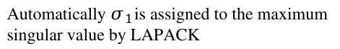
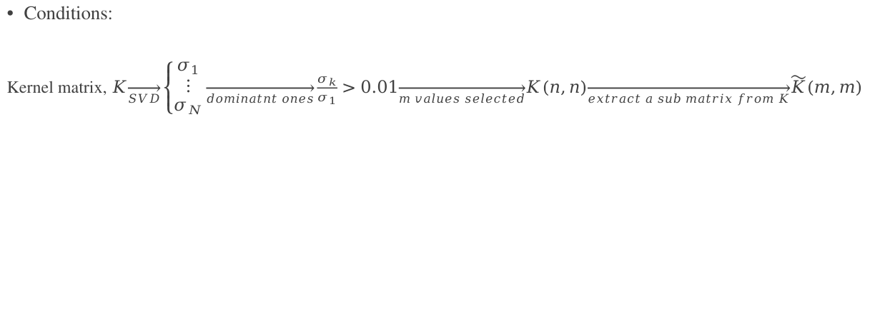
SVD of the atomic chains ~ method (2) ~
Conditions:
Kernel matrix, $K\overset{→}{SVD}\left\{\begin{aligned}σ_{1} \\ ⋮ \\ σ_{N}\end{aligned}\right.\overset{→}{dominatnt ones}\frac{σ_{k}}{σ_{1}}>0.01\overset{→}{m values selected}K(n,n)\overset{→}{extract a sub matrix from K}\tilde{K}(m,m)$
Automatically $σ_{1}$is assigned to the maximum singular value by LAPACK

Slide 21
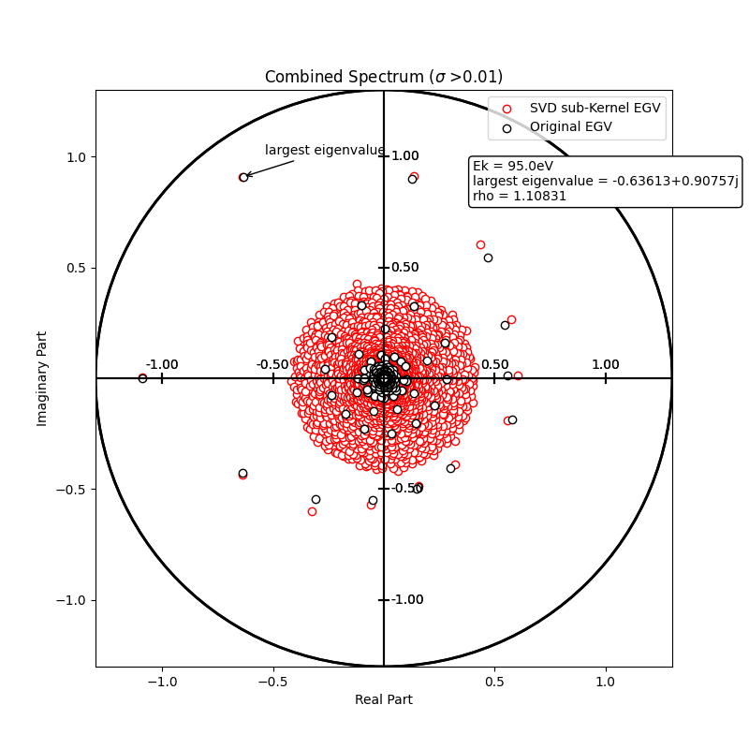
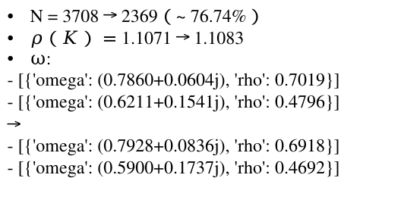
SVD of the atomic chains ~ (a) ~
N = 3708 → 2369（~ 76.74%）
$ρ（K）=$ 1.1071 → 1.1083
$ω$:
- [{'omega': (0.7860+0.0604j), 'rho': 0.7019}]
- [{'omega': (0.6211+0.1541j), 'rho': 0.4796}]
→
- [{'omega': (0.7928+0.0836j), 'rho': 0.6918}]
- [{'omega': (0.5900+0.1737j), 'rho': 0.4692}]
(a)
Red is behind the black !
Ni

Slide 22
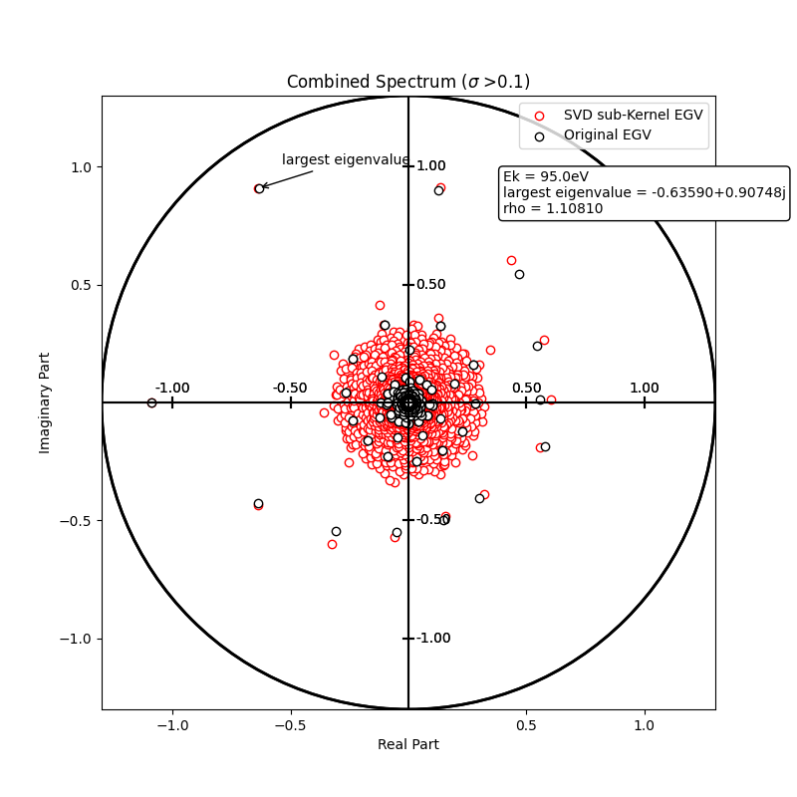
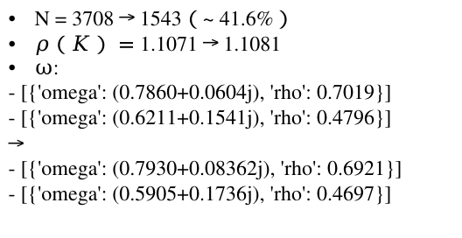
SVD of the atomic chains ~ (a) ~
N = 3708 → 1543（~ 41.6%）
$ρ（K）=$ 1.1071 → 1.1081
$ω$:
- [{'omega': (0.7860+0.0604j), 'rho': 0.7019}]
- [{'omega': (0.6211+0.1541j), 'rho': 0.4796}]
→
- [{'omega': (0.7930+0.08362j), 'rho': 0.6921}]
- [{'omega': (0.5905+0.1736j), 'rho': 0.4697}]
(a)
Red is behind the black !
Ni

Slide 23
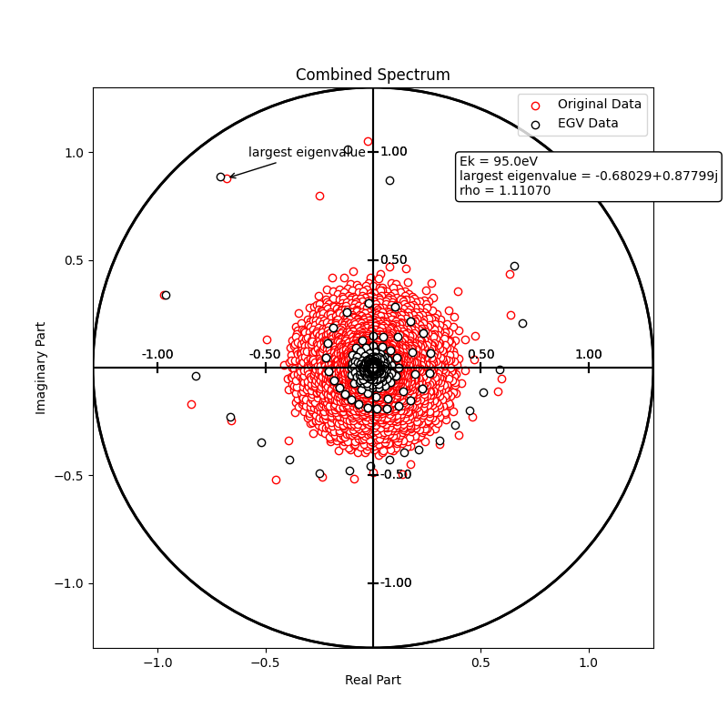
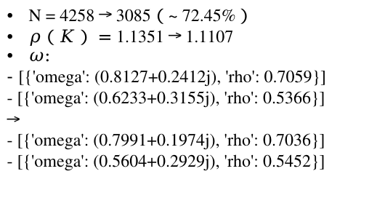
SVD of the atomic chains ~ (b) ~
N = 4258 → 3085（~ 72.45%）
$ρ（K）=$ 1.1351 → 1.1107
$ω$:
- [{'omega': (0.8127+0.2412j), 'rho': 0.7059}]
- [{'omega': (0.6233+0.3155j), 'rho': 0.5366}]
→
- [{'omega': (0.7991+0.1974j), 'rho': 0.7036}]
- [{'omega': (0.5604+0.2929j), 'rho': 0.5452}]
(b)
The red and black are close...
O
Ti

Slide 24
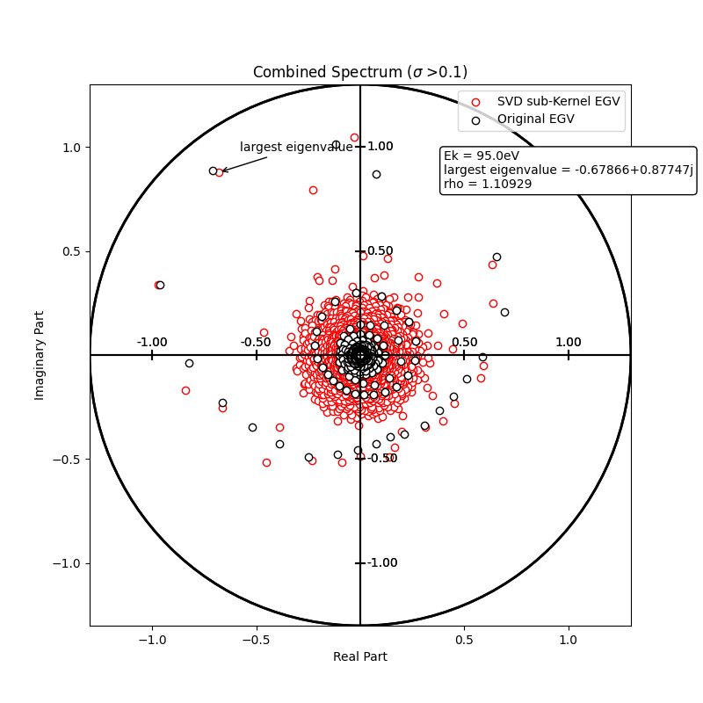
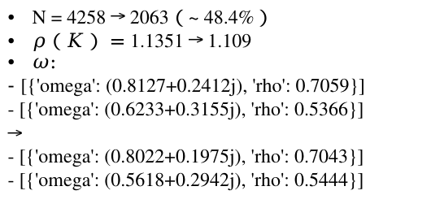
SVD of the atomic chains ~ (b) ~
N = 4258 → 2063（~ 48.4%）
$ρ（K）=$ 1.1351 → 1.109
$ω$:
- [{'omega': (0.8127+0.2412j), 'rho': 0.7059}]
- [{'omega': (0.6233+0.3155j), 'rho': 0.5366}]
→
- [{'omega': (0.8022+0.1975j), 'rho': 0.7043}]
- [{'omega': (0.5618+0.2942j), 'rho': 0.5444}]
(b)
The red and black are close...
O
Ti

Slide 25
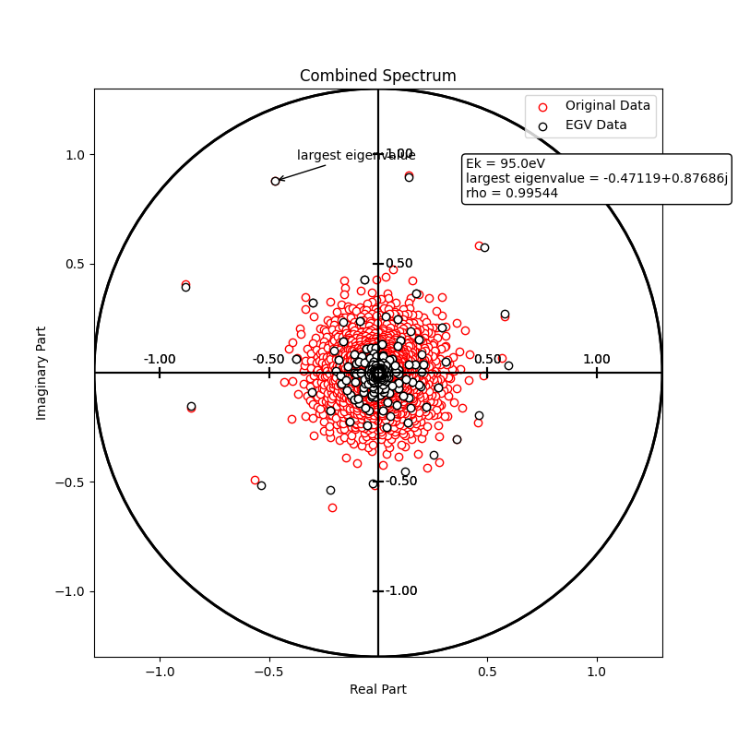
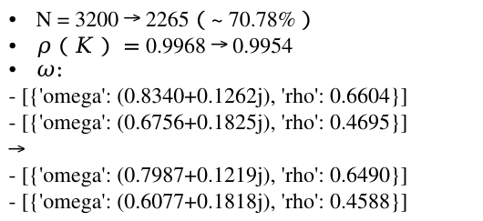
SVD of the atomic chains ~ (c) ~
N = 3200 → 2265（~ 70.78%）
$ρ（K）=$ 0.9968 → 0.9954
$ω$:
- [{'omega': (0.8340+0.1262j), 'rho': 0.6604}]
- [{'omega': (0.6756+0.1825j), 'rho': 0.4695}]
→
- [{'omega': (0.7987+0.1219j), 'rho': 0.6490}]
- [{'omega': (0.6077+0.1818j), 'rho': 0.4588}]
(c)
Red is behind the black !
Sr

Slide 26
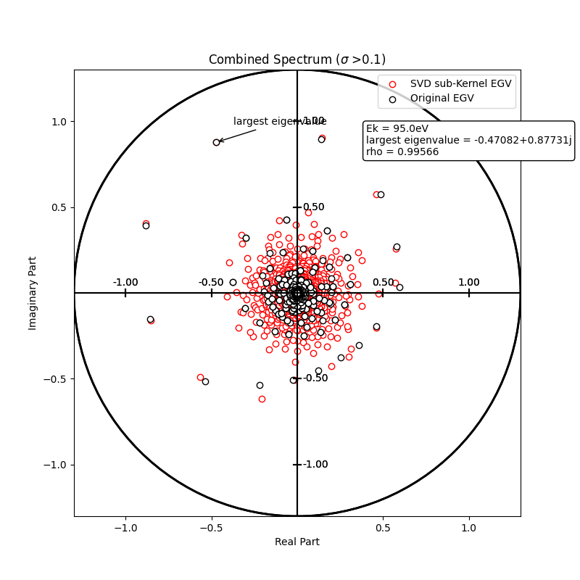
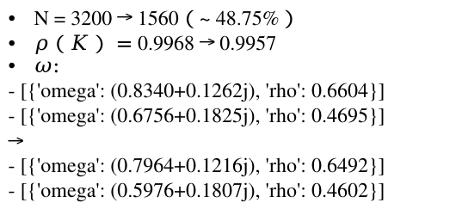
SVD of the atomic chains ~ (c) ~
N = 3200 → 1560（~ 48.75%）
$ρ（K）=$ 0.9968 → 0.9957
$ω$:
- [{'omega': (0.8340+0.1262j), 'rho': 0.6604}]
- [{'omega': (0.6756+0.1825j), 'rho': 0.4695}]
→
- [{'omega': (0.7964+0.1216j), 'rho': 0.6492}]
- [{'omega': (0.5976+0.1807j), 'rho': 0.4602}]
(c)
Red is behind the black !
Sr

Slide 27
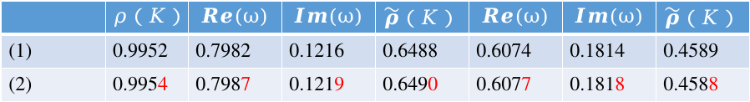
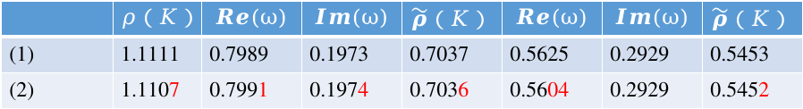
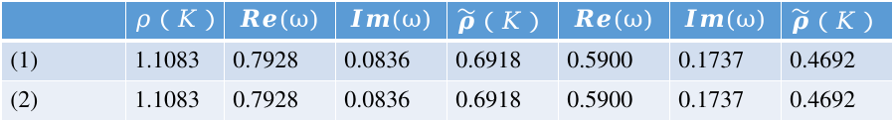
Comparison of methods (1) and (2)
(a)
76.74%
 | $$ρ（K）$$ | $$Re(ω)$$ | $$Im(ω)$$ | $$\tilde{ρ}（K）$$ | $$Re(ω)$$ | $$Im(ω)$$ | $$\tilde{ρ}（K）$$
(1) | 1.1083 | 0.7928 | 0.0836 | 0.6918 | 0.5900 | 0.1737 | 0.4692
(2) | 1.1083 | 0.7928 | 0.0836 | 0.6918 | 0.5900 | 0.1737 | 0.4692
Original
1.1071
0.7860
0.0604
0.7019
0.6211
0.1541
0.4796
(b)
72.45%
 | $$ρ（K）$$ | $$Re(ω)$$ | $$Im(ω)$$ | $$\tilde{ρ}（K）$$ | $$Re(ω)$$ | $$Im(ω)$$ | $$\tilde{ρ}（K）$$
(1) | 1.1111 | 0.7989 | 0.1973 | 0.7037 | 0.5625 | 0.2929 | 0.5453
(2) | 1.1107 | 0.7991 | 0.1974 | 0.7036 | 0.5604 | 0.2929 | 0.5452
Original
1.1351
0.8127
0.2412
0.7059
0.6233
0.3155
0.5366
(c)
70.78%
 | $$ρ（K）$$ | $$Re(ω)$$ | $$Im(ω)$$ | $$\tilde{ρ}（K）$$ | $$Re(ω)$$ | $$Im(ω)$$ | $$\tilde{ρ}（K）$$
(1) | 0.9952 | 0.7982 | 0.1216 | 0.6488 | 0.6074 | 0.1814 | 0.4589
(2) | 0.9954 | 0.7987 | 0.1219 | 0.6490 | 0.6077 | 0.1818 | 0.4588
Original
0.9968
0.8340
0.1262
0.6604
0.6756
0.1825
0.4695

Slide 28
Didier’s idea ~ What if we reduce lmax for ω？
(c)
(a)
(b)
lmax:
True_ke: 20
Testing lmax: 8,9,10,...20
lmax:
True_ke: 19
Testing lmax: 11,12,13,...19
Ni
Sr
lmax:
True_ke:
{Ti: 20,21, O: 15,16}
Testing lmax:
{Ti: 9,12,15,18,21, O: 8,11,14,17,20}
O
Ti

Slide 29
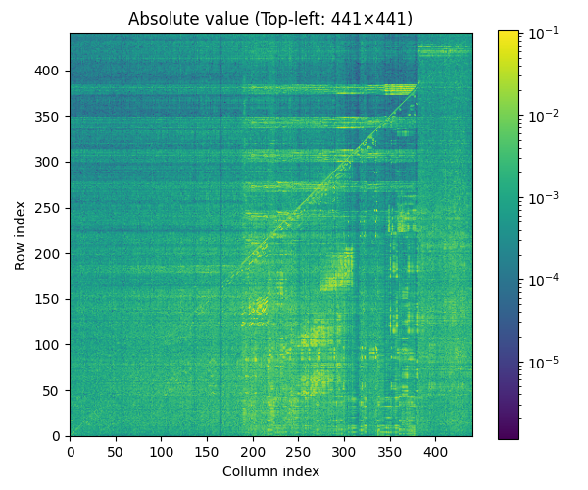
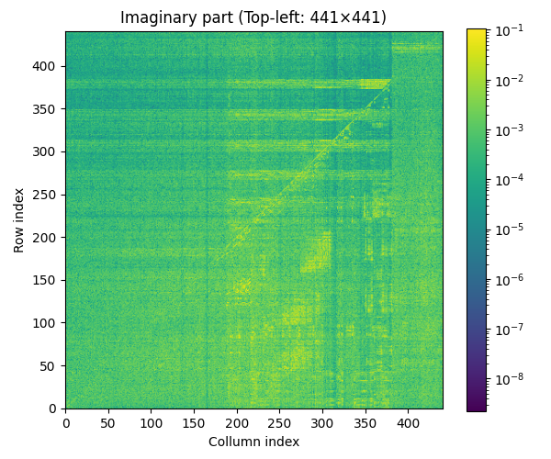
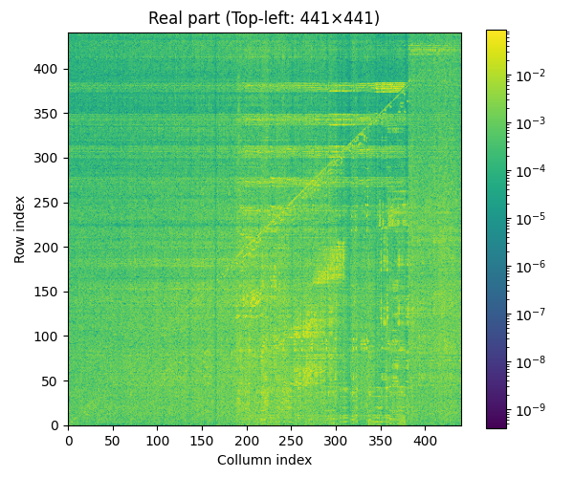
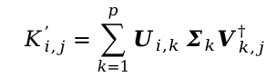
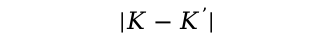
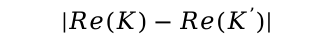
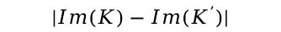
Difference of the full and 41.6% cut Kernel matrices
(a)
$$|K−K^{’}|$$
$$|Im(K)−Im(K^{’})|$$
$$|Re(K)−Re(K^{’})|$$
$${ K}_{i,j}^{’}=\sum_{k=1}^{p}{U_{i,k}}Σ_{k}V_{k,j}^{†}$$
lmax = 20
Dimension of K: 21*21 = 441
p: Number of the selected singular values
Ni

Slide 30
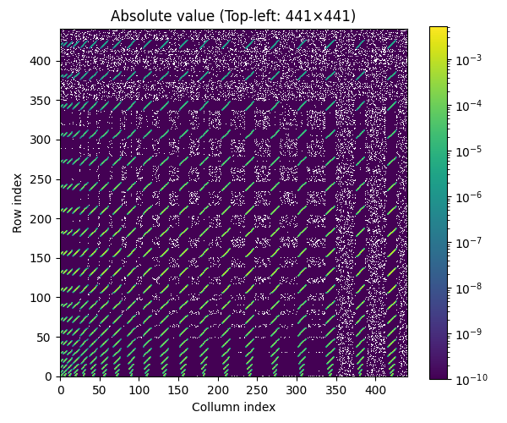
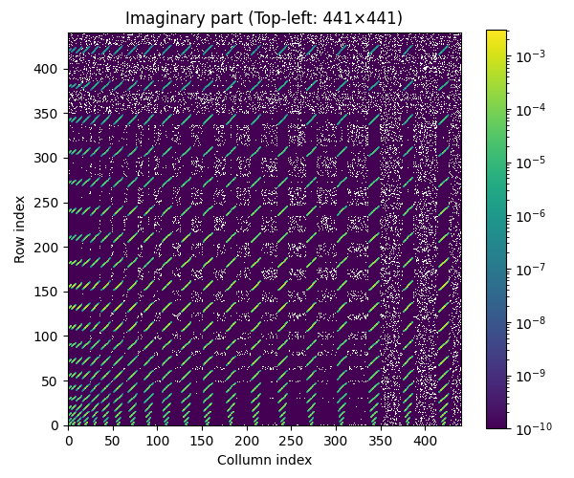
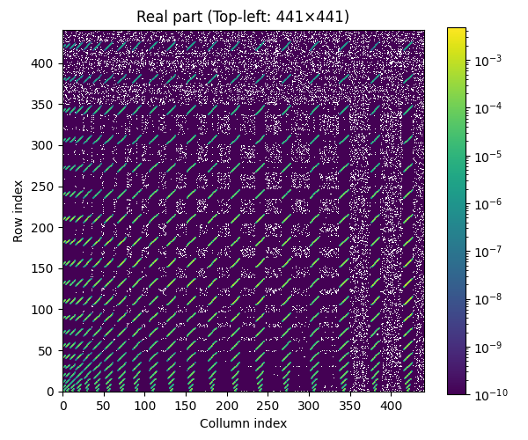
*Any point < 10^(-100) is in white.

Slide 31
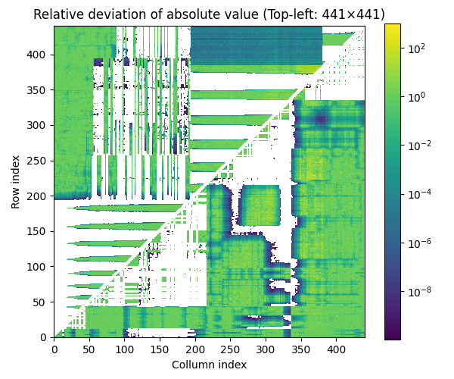
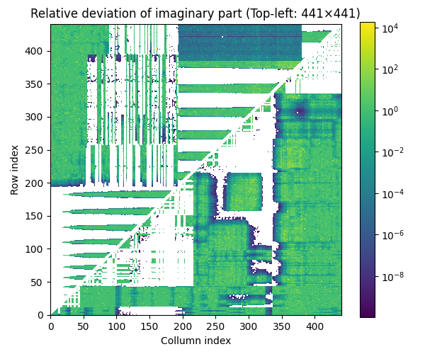
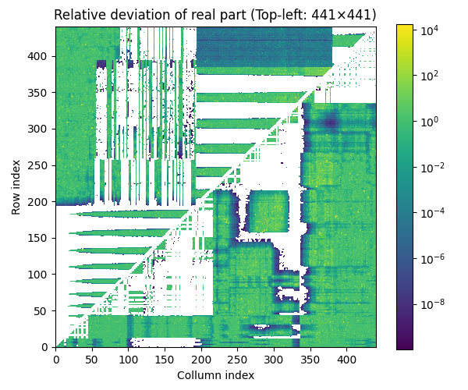
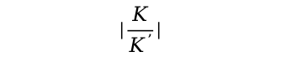
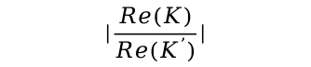
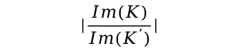
Difference of the full and 41.6% cut Kernel matrices
(a)
$$|\frac{Im(K)}{Im(K^{’})}|$$
$$|\frac{Re(K)}{Re(K^{’})}|$$
$$|\frac{K}{K^{’}}|$$
lmax = 20
Dimension of K: 21*21 = 441
*Any point < 10^(-10) is in white.
Ni

Slide 32
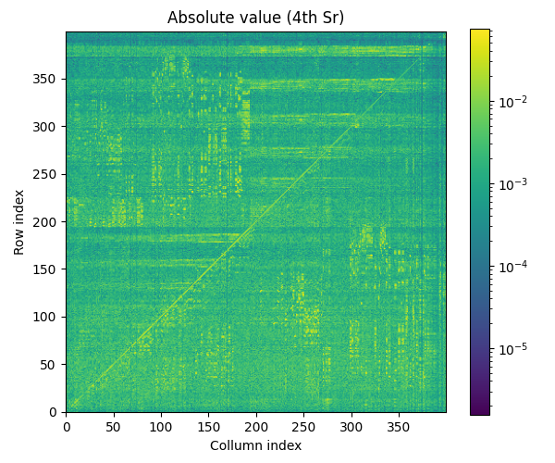
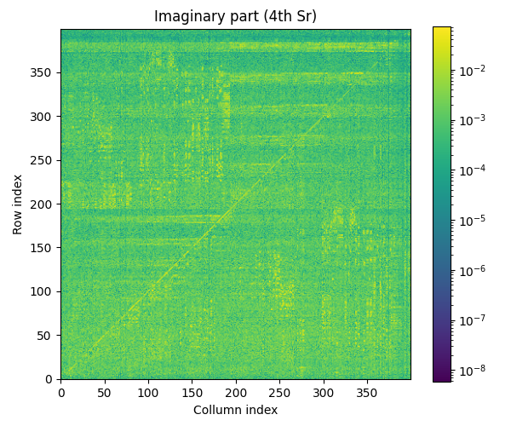
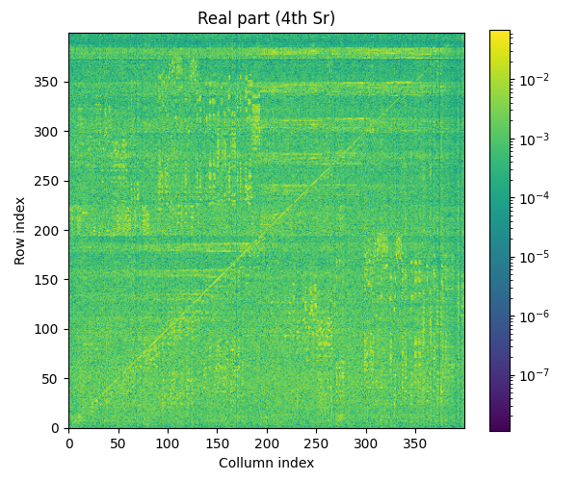
Difference of the full and 48.75% cut Kernel matrices
(c)
$$|K−K^{’}|$$
$$|Im(K)−Im(K^{’})|$$
$$|Re(K)−Re(K^{’})|$$
lmax = 19
Dimension of K: 20*20 = 400
Sr

Slide 33



Difference of the full and 48.75% cut Kernel matrices
(c)
$$|\frac{K}{K^{’}}|$$
$$|\frac{Im(K)}{Im(K^{’})}|$$
$$|\frac{Re(K)}{Re(K^{’})}|$$
lmax = 19
Dimension of K: 20*20 = 400
Sr

Slide 34


(a)
Ni

Slide 35


(c)
Sr

Slide 36


REAL(K(i,j))
lmax=20
K(442:472, :100)
lmax=5
K(37:67, :100)

Slide 37

Removing eigenvalues near 0
(a)
Photoelectron energy：379.1 eV
lmax：24
Dimension of K：4375
Method：
Finding all eigenvalues meeting a condition,$\frac{|λ_{i}|}{ρ（K）}$＜threshold
Result：
Thresold = 0.1 → #（eigenvalues） is 4143/4375（～95%）
Threshold = 0.01 → #（eigenvalues） is 3327/4375（～76%）
Ni

Slide 38


Complex plan
Threshold=0.1

Slide 39

Complex plan
Threshold=0.01

Slide 40
(a)
T¹
T¹
G¹²
G¹³
G¹⁴
G²¹
T²
G²³
G²⁴
G³¹
G³²
G³⁴
T³
G⁴¹
G⁴²
G⁴³
T⁴
Ni
Photoelectron energy：379.1 eV
lmax：24
Dimension of K：4375

Slide 41

Real part of the matrix elements of K’ and K in ~ eigenvalues decomposition
100
(a)
625
T¹
Ni

Slide 42

100
625
T²

Slide 43

100
625
T³

Slide 44

100
625
T⁴

Slide 45

100
625
T⁵

Slide 46

100
625
T⁶

Slide 47

100
625
T⁷

Slide 48

625
G¹²

Slide 49

625
G²¹

Slide 50

Imaginary part of the matrix elements of K’ and K in ~ eigenvalues decomposition
100
625
T¹

Slide 51

100
625
T²

Slide 52

100
625
T³

Slide 53

100
625
T⁴

Slide 54

100
625
T⁵

Slide 55

100
625
T⁶

Slide 56

100
625
T⁷

Slide 57

625
G¹²

Slide 58

625
G²¹

Slide 59

Modulus of the matrix elements of K’ and K in ~ eigenvalues decomposition
100
625
T¹

Slide 60

625
T²

Slide 61

625
T³

Slide 62

625
T⁴

Slide 63

625
T⁵

Slide 64

625
T⁶

Slide 65

625
T⁷

Slide 66

625
G¹²

Slide 67

625
G²¹

Slide 68

625
G¹³

Slide 69

625
G³¹

Slide 70

625
G¹⁴

Slide 71

625
G⁴¹

Slide 72

625
G¹⁵

Slide 73

625
G⁵¹

Slide 74

625
G¹⁶

Slide 75

625
G⁶¹

Slide 76

625
G¹⁷

Slide 77

625
G⁷¹

Slide 78

Real part of the matrix elements of K’ and K in ~ SVD
100
625
T¹

Slide 79

100
625
T²

Slide 80

100
625
T³

Slide 81

100
625
T⁴

Slide 82

100
625
T⁵

Slide 83

100
625
T⁶

Slide 84

100
625
T⁷

Slide 85

625
G¹²

Slide 86

625
G²¹

Slide 87

Imagonary part of the matrix elements of K’ and K in ~ SVD
100
625
T¹

Slide 88

100
625
T²

Slide 89

100
625
T³

Slide 90

100
625
T⁴

Slide 91

100
625
T⁵

Slide 92

100
625
T⁶

Slide 93

100
625
T⁷

Slide 94

625
G¹²

Slide 95

625
G²¹

Slide 96

Real part of the matrix elements of K’ and K in ~ SVD
50 Cu(001) cluster
photoelectron kinetic energy: 95.0eV
lmax: 8 or 9 depending on each atom

Slide 97

625
T¹

Slide 98

625
T²

Slide 99

625
T³

Slide 100

625
T⁴

Slide 101

625
T⁵

Slide 102

625
T⁶

Slide 103

625
T⁷

Slide 104

625
T⁸

Slide 105

625
T⁹

Slide 106

625
T¹⁰

Slide 107

625
G¹²

Slide 108

625
G²¹

Slide 109

Imaginary part of the matrix elements of K’ and K in ~ SVD
625
T¹

Slide 110

625
T²

Slide 111

625
T³

Slide 112

625
T⁴

Slide 113

625
T⁵

Slide 114

625
T⁶

Slide 115

625
T⁷

Slide 116

625
T⁸

Slide 117

625
T⁹

Slide 118

625
T¹⁰

Slide 119

625
G¹²

Slide 120

625
G²¹

Slide 121
Real part of the matrix elements of K’ and K in ~ eigenvalues decomposition
50 Cu(001) cluster
photoelectron kinetic energy: 95.0eV
lmax: 8 or 9 depending on each atom

Slide 122

625
T¹

Slide 123

625
T²

Slide 124

625
T³

Slide 125

625
T⁴

Slide 126

625
T⁵

Slide 127

625
T⁶

Slide 128

625
T⁷

Slide 129

625
T⁸

Slide 130

625
T⁹

Slide 131

625
T¹⁰

Slide 132

625
G¹²

Slide 133

625
G²¹

Slide 134
Modulus of the matrix elements of K’ and K in ~ eigenvalues decomposition
50 Cu(001) cluster
photoelectron kinetic energy: 95.0eV
lmax: 8 or 9 depending on each atom

Slide 135

625
T¹

Slide 136

625
T²

Slide 137

625
T³

Slide 138

625
T⁴

Slide 139

625
T⁵

Slide 140

625
T⁶

Slide 141

625
T⁷

Slide 142

625
T⁸

Slide 143

625
T⁹

Slide 144

625
T¹⁰

Slide 145

625
G¹²

Slide 146

625
G²¹

Slide 147

625
G¹³

Slide 148

625
G³¹

Slide 149

625
G¹⁴

Slide 150

625
G⁴¹

Slide 151

625
G¹⁵

Slide 152

625
G⁵¹

Slide 153

625
G¹⁶

Slide 154

625
G⁶¹

Slide 155

625
G¹⁷

Slide 156

625
G⁷¹

Slide 157

625
G¹⁸

Slide 158

625
G⁸¹

Slide 159

625
G¹⁹

Slide 160

625
G⁹¹

Slide 161

625
G¹¹⁰

Slide 162

625
G¹⁰¹

Slide 163

Modulus of the matrix elements of K’ and K in ~ singlar values decomposition
(a)
625
T¹
Ni

Slide 164

625
T²

Slide 165

625
T³

Slide 166

625
T⁴

Slide 167

625
T⁵

Slide 168

625
T⁶

Slide 169

625
T⁷

Slide 170

625
G¹²

Slide 171

Modulus of the matrix elements of K_egv and K_SVD
625
T¹

Slide 172

625
T²

Slide 173

625
T³

Slide 174

625
T⁴

Slide 175

625
T⁵

Slide 176

625
T⁶

Slide 177

625
T⁷

Slide 178

625
G¹²

